Slide 1


Springboard Data Science Capstone Two Presentation By: Bini Teklehaimanot

Slide 2
Agenda
Problem Identification
Recommendation and Key Findings
Modeling Results and Analysis
Summary and Conclusion

Slide 3

Problem Identification
What factors influence healthcare access?
Improve access for all races
Decrease discriminations that hinder access

Slide 4

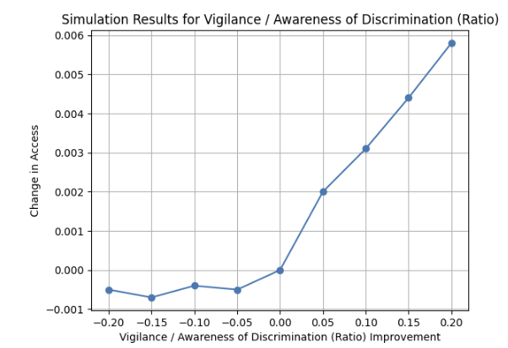
Recommendations and Key Findings
Improvement in Vigilance improves Access
Decrease in Discrimination Improves Access
Depression Events Need further Investigation

Slide 5

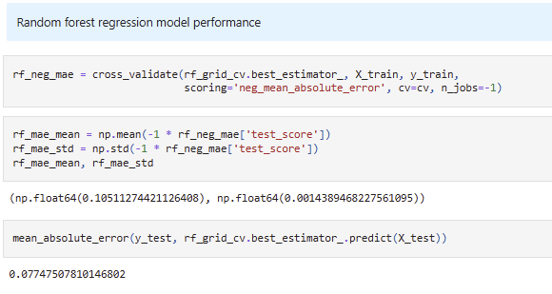
Modeling Results and Analysis
Linear Regression
Random Forest Model – best mean MAE, stable Std Dev MAE, and best test set MAE
Light Grading Boosting Model

Slide 6

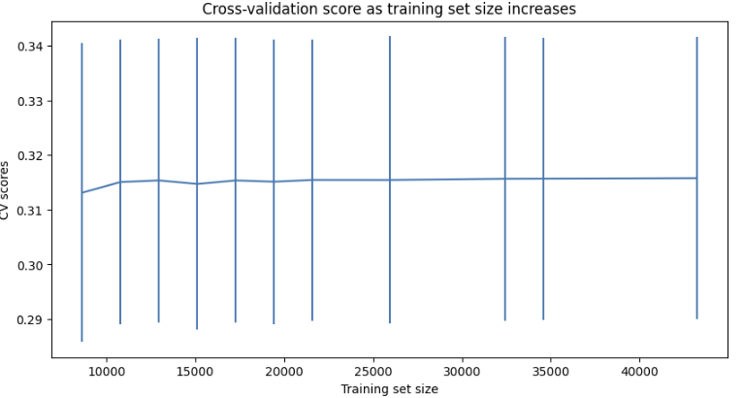
Summary and Conclusion
The Random Forest Model is chosen for its accuracy and effectiveness in healthcare access
Focus on policy changes to improve access
Additional data is not required

